Slide 1
THIS IS YOUR PRESENTATION TITLE

Slide 2
INSTRUCTIONS FOR USE
EDIT IN GOOGLE SLIDES
Click on the button under the presentation preview that says "Use as Google Slides Theme".
You will get a copy of this document on your Google Drive and will be able to edit, add or delete slides.
You have to be signed in to your Google account.
EDIT IN POWERPOINT®
Click on the button under the presentation preview that says "Download as PowerPoint template". You will get a .pptx file that you can edit in PowerPoint.
Remember to download and install the fonts used in this presentation (you’ll find the links to the font files needed in the Presentation design slide)
More info on how to use this template at www.slidescarnival.com/help-use-presentation-template
This template is free to use under Creative Commons Attribution license. You can keep the Credits slide or mention SlidesCarnival and other resources used in a slide footer.

Slide 3
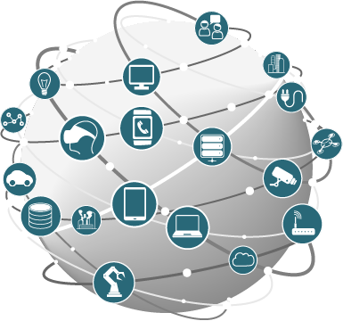
Internet of Thing!
HTH チーム

Slide 4
ドー・マィン・フン
Nguyễn Văn Hoàn
Hoàng Anh Tuấn
Đỗ Mạnh Hùng

Slide 5
IOTとは何ですか？
1

Slide 6
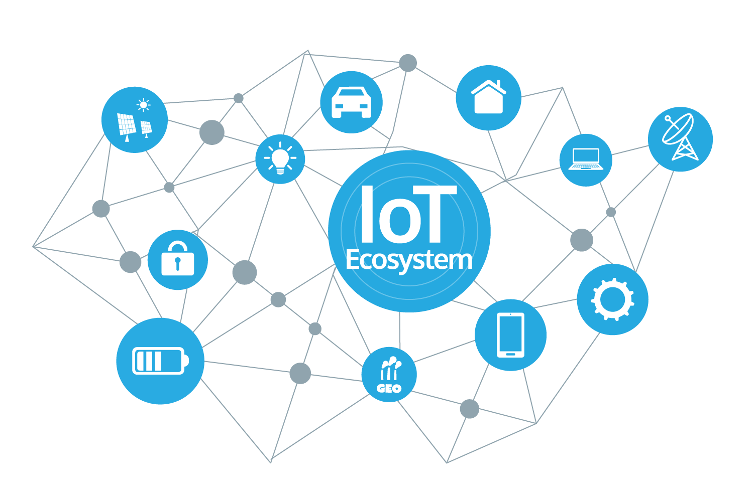
物のインタネット
接続された
情報交換する

Slide 7
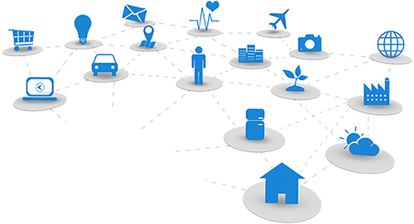
歴史
1999年、Internet of Thingsという用語にはKevin Ashtonが初めて使ったとされた。
2017年 までに、多くのオブジェクトに適用されている。

Slide 8
接続
Wifi, Bluetooth, 3G, 4G, ZigBee, 赤外線 ...
設備：テレビ、車、電話、電球、時計、衣服 …
他のオブジェクトの接続や相互作用は簡単です。

Slide 9
物のインタネット
接続された
情報交換する

Slide 10
Quotations are commonly printed as a means of inspiration and to invoke philosophical thoughts from the reader.

Slide 11
BIG CONCEPT
Bring the attention of your audience over a key concept using icons or illustrations

Slide 12
YOU CAN ALSO SPLIT YOUR CONTENT
White
Is the color of milk and fresh snow, the color produced by the combination of all the colors of the visible spectrum.
Black
Is the color of coal, ebony, and of outer space. It is the darkest color, the result of the absence of or complete absorption of light.

Slide 13
IN TWO OR THREE COLUMNS
Yellow
Is the color of gold, butter and ripe lemons. In the spectrum of visible light, yellow is found between green and orange.
Blue
Is the colour of the clear sky and the deep sea. It is located between violet and green on the optical spectrum.
Red
Is the color of blood, and because of this it has historically been associated with sacrifice, danger and courage.

Slide 14

A PICTURE IS WORTH A THOUSAND WORDS
A complex idea can be conveyed with just a single still image, namely making it possible to absorb large amounts of data quickly.

Slide 15
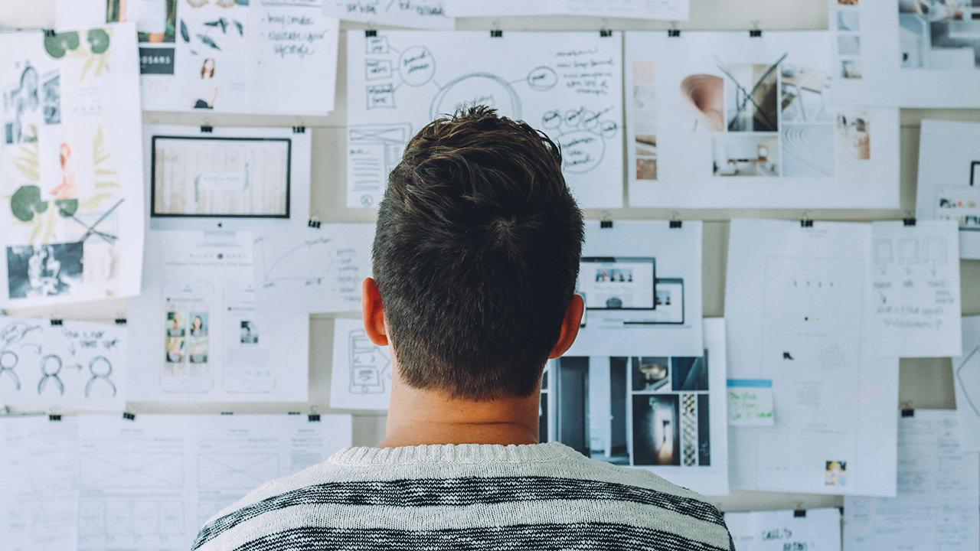
Want big impact?
USE BIG IMAGE

Slide 16
USE CHARTS TO EXPLAIN YOUR IDEAS
White
Gray
Black

Slide 17
AND TABLES TO COMPARE DATA
 | A | B | C
Yellow | 10 | 20 | 7
Blue | 30 | 15 | 10
Orange | 5 | 24 | 16

Slide 18
MAPS
OUR OFFICE

Slide 19
89,526,124
Whoa! That’s a big number, aren’t you proud?

Slide 20
89,526,124$
185,244 users
100%
That’s a lot of money
And a lot of users
Total success!

Slide 21
OUR PROCESS IS EASY
second
last
first
first

Slide 22
LET’S REVIEW SOME CONCEPTS
Yellow
Is the color of gold, butter and ripe lemons. In the spectrum of visible light, yellow is found between green and orange.
Blue
Is the colour of the clear sky and the deep sea. It is located between violet and green on the optical spectrum.
Red
Is the color of blood, and because of this it has historically been associated with sacrifice, danger and courage.
Yellow
Is the color of gold, butter and ripe lemons. In the spectrum of visible light, yellow is found between green and orange.
Blue
Is the colour of the clear sky and the deep sea. It is located between violet and green on the optical spectrum.
Red
Is the color of blood, and because of this it has historically been associated with sacrifice, danger and courage.

Slide 23
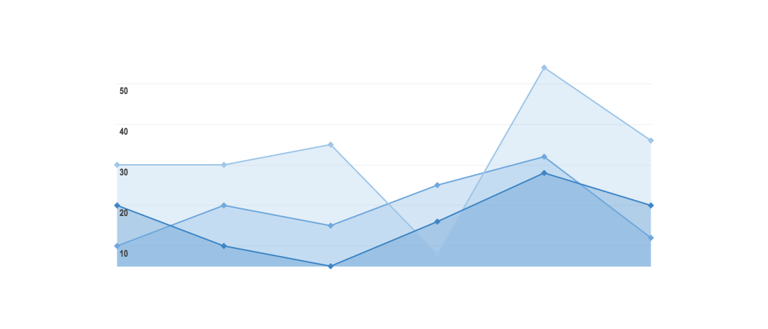
GRAPH TITLE
You can insert graphs from Google Sheets

Slide 24
Place your screenshot here
ANDROID PROJECT
Show and explain your web, app or software projects using these gadget templates.

Slide 25
iPHONE PROJECT
Show and explain your web, app or software projects using these gadget templates.
Place your screenshot here

Slide 26
Place your screenshot here
TABLET PROJECT
Show and explain your web, app or software projects using these gadget templates.

Slide 27
Place your screenshot here
DESKTOP PROJECT
Show and explain your web, app or software projects using these gadget templates.

Slide 28
THANKS!
Any questions?
You can find me at
@username & user@mail.me

Slide 29
CREDITS
Special thanks to all the people who made and released these awesome resources for free:
Presentation template by SlidesCarnival
Photographs by Startup Stock Photos

Slide 30
PRESENTATION DESIGN
This presentation uses the following typographies and colors:
Titles: Roboto Condensed
Body copy: Roboto Condensed
You can download the fonts on this page:
https://material.io/guidelines/resources/roboto-noto-fonts.html
Navy #3f5378 · Dark navy #263248 · Yellow #ff9800
You don’t need to keep this slide in your presentation. It’s only here to serve you as a design guide if you need to create new slides or download the fonts to edit the presentation in PowerPoint®

Slide 31
SlidesCarnival icons are editable shapes.
This means that you can:
Resize them without losing quality.
Change line color, width and style.
Isn’t that nice? :)
Examples:

Slide 32
😉
Now you can use any emoji as an icon!
And of course it resizes without losing quality and you can change the color.
How? Follow Google instructions https://twitter.com/googledocs/status/730087240156643328
✋👆👉👍👤👦👧👨👩👪💃🏃💑❤😂😉😋😒😭👶😸🐟🍒🍔💣📌📖🔨🎃🎈🎨🏈🏰🌏🔌🔑 and many more...

